Slide 1
Weekly report: Team Project Development
Week number: 06
Date: 03/11/2025
Supervisor: Dr. Marina Blohm
Group members: Luis Urhahn, Ahmed Sallam, Ceren Cetin, Sohail Mansuri
Presenter:Sila Ceren Cetin

Slide 2
Tasks of the week
Update on the electricity prices/LCOE in Syria
Progress: WindPro Simulation
Logistics
QGIS
Sila Ceren Cetin

Slide 3
Update electricity prices Syria
Research on the current electricity prices in Syria:
Households: 1.6 €Cents/kWh
Industry: 4.6 €Cent/kWh
The Syrian Pound has a volatile and variable exchange rate, making a precise conversion unreliable.
[2] Source: Syria energy prices | GlobalPetrolPrices.com
Worldwide LCOE for Wind turbine (onshore, 2024):
LCOE: 4.3 – 9.2 €Cents/kWh
[3] Source: https://www.ise.fraunhofer.de/content/dam/ise/en/documents/publications/studies/EN2024_ISE_Study_Levelized_Cost_of_Electricity_Renewable_Energy_Technologies.pdf
Shows that our turbine needs to be very cost-efficient!
Sila Ceren Cetin

Slide 4
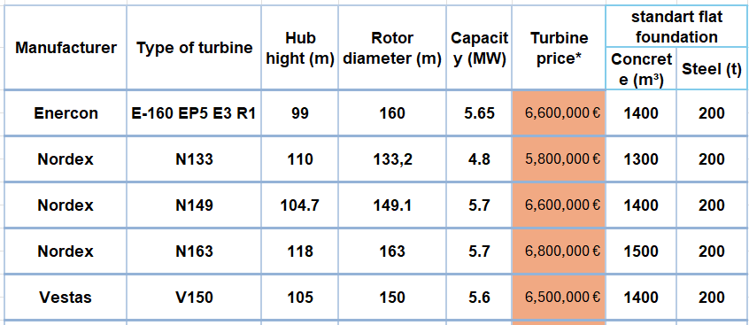
Rough estimation of wind turbine Price
Determining the true price of a 5 MW wind turbine is challenging due to differences between manufacturers.
Initial cost estimation for calculations is set at 6.5 million euros.
Price range for 5 MW turbines from different manufacturers is 5.5 to 7 million euros.
Project development lecture
Sila Ceren Cetin

Slide 5
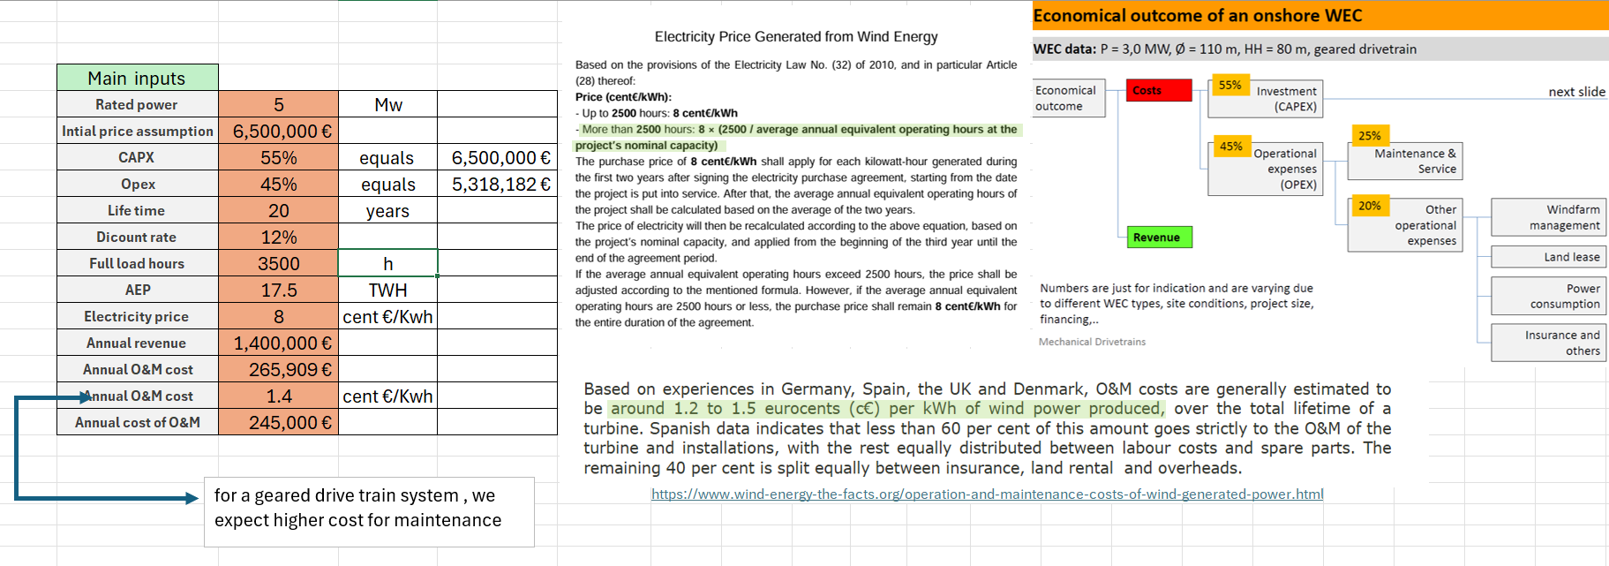
The initial assumptions and inputs for our Excel sheet
Electricity price based on Syria’s Electricity Law No. 32 (2010): guaranteed at 8 cent€/kWh for first 2 years
If annual production exceeds 2500 hours, price adjusted by formula; otherwise, remains at 8 cent€/kWh
European O&M cost reference: 1.2–1.5 cent€/kWh (Germany, Spain, UK, Denmark)
[4]
Cost breakdown: 55% investment (CAPEX), 45% operational expenses (OPEX), maintenance = 25% of OPEX
Own source
Sila Ceren Cetin

Slide 6
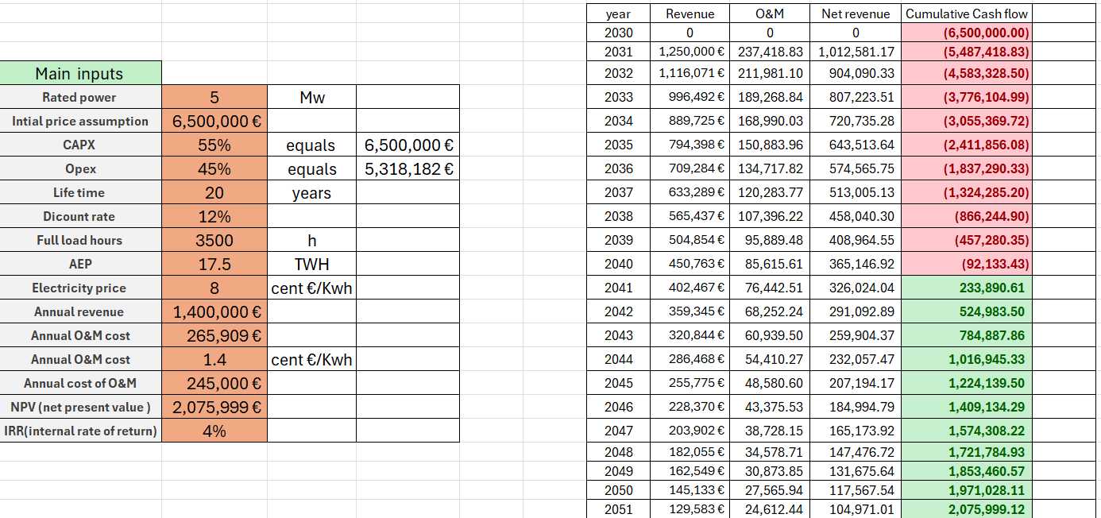
The main structure and the calculations of NPV and discount rate
Own source
Sila Ceren Cetin

Slide 7
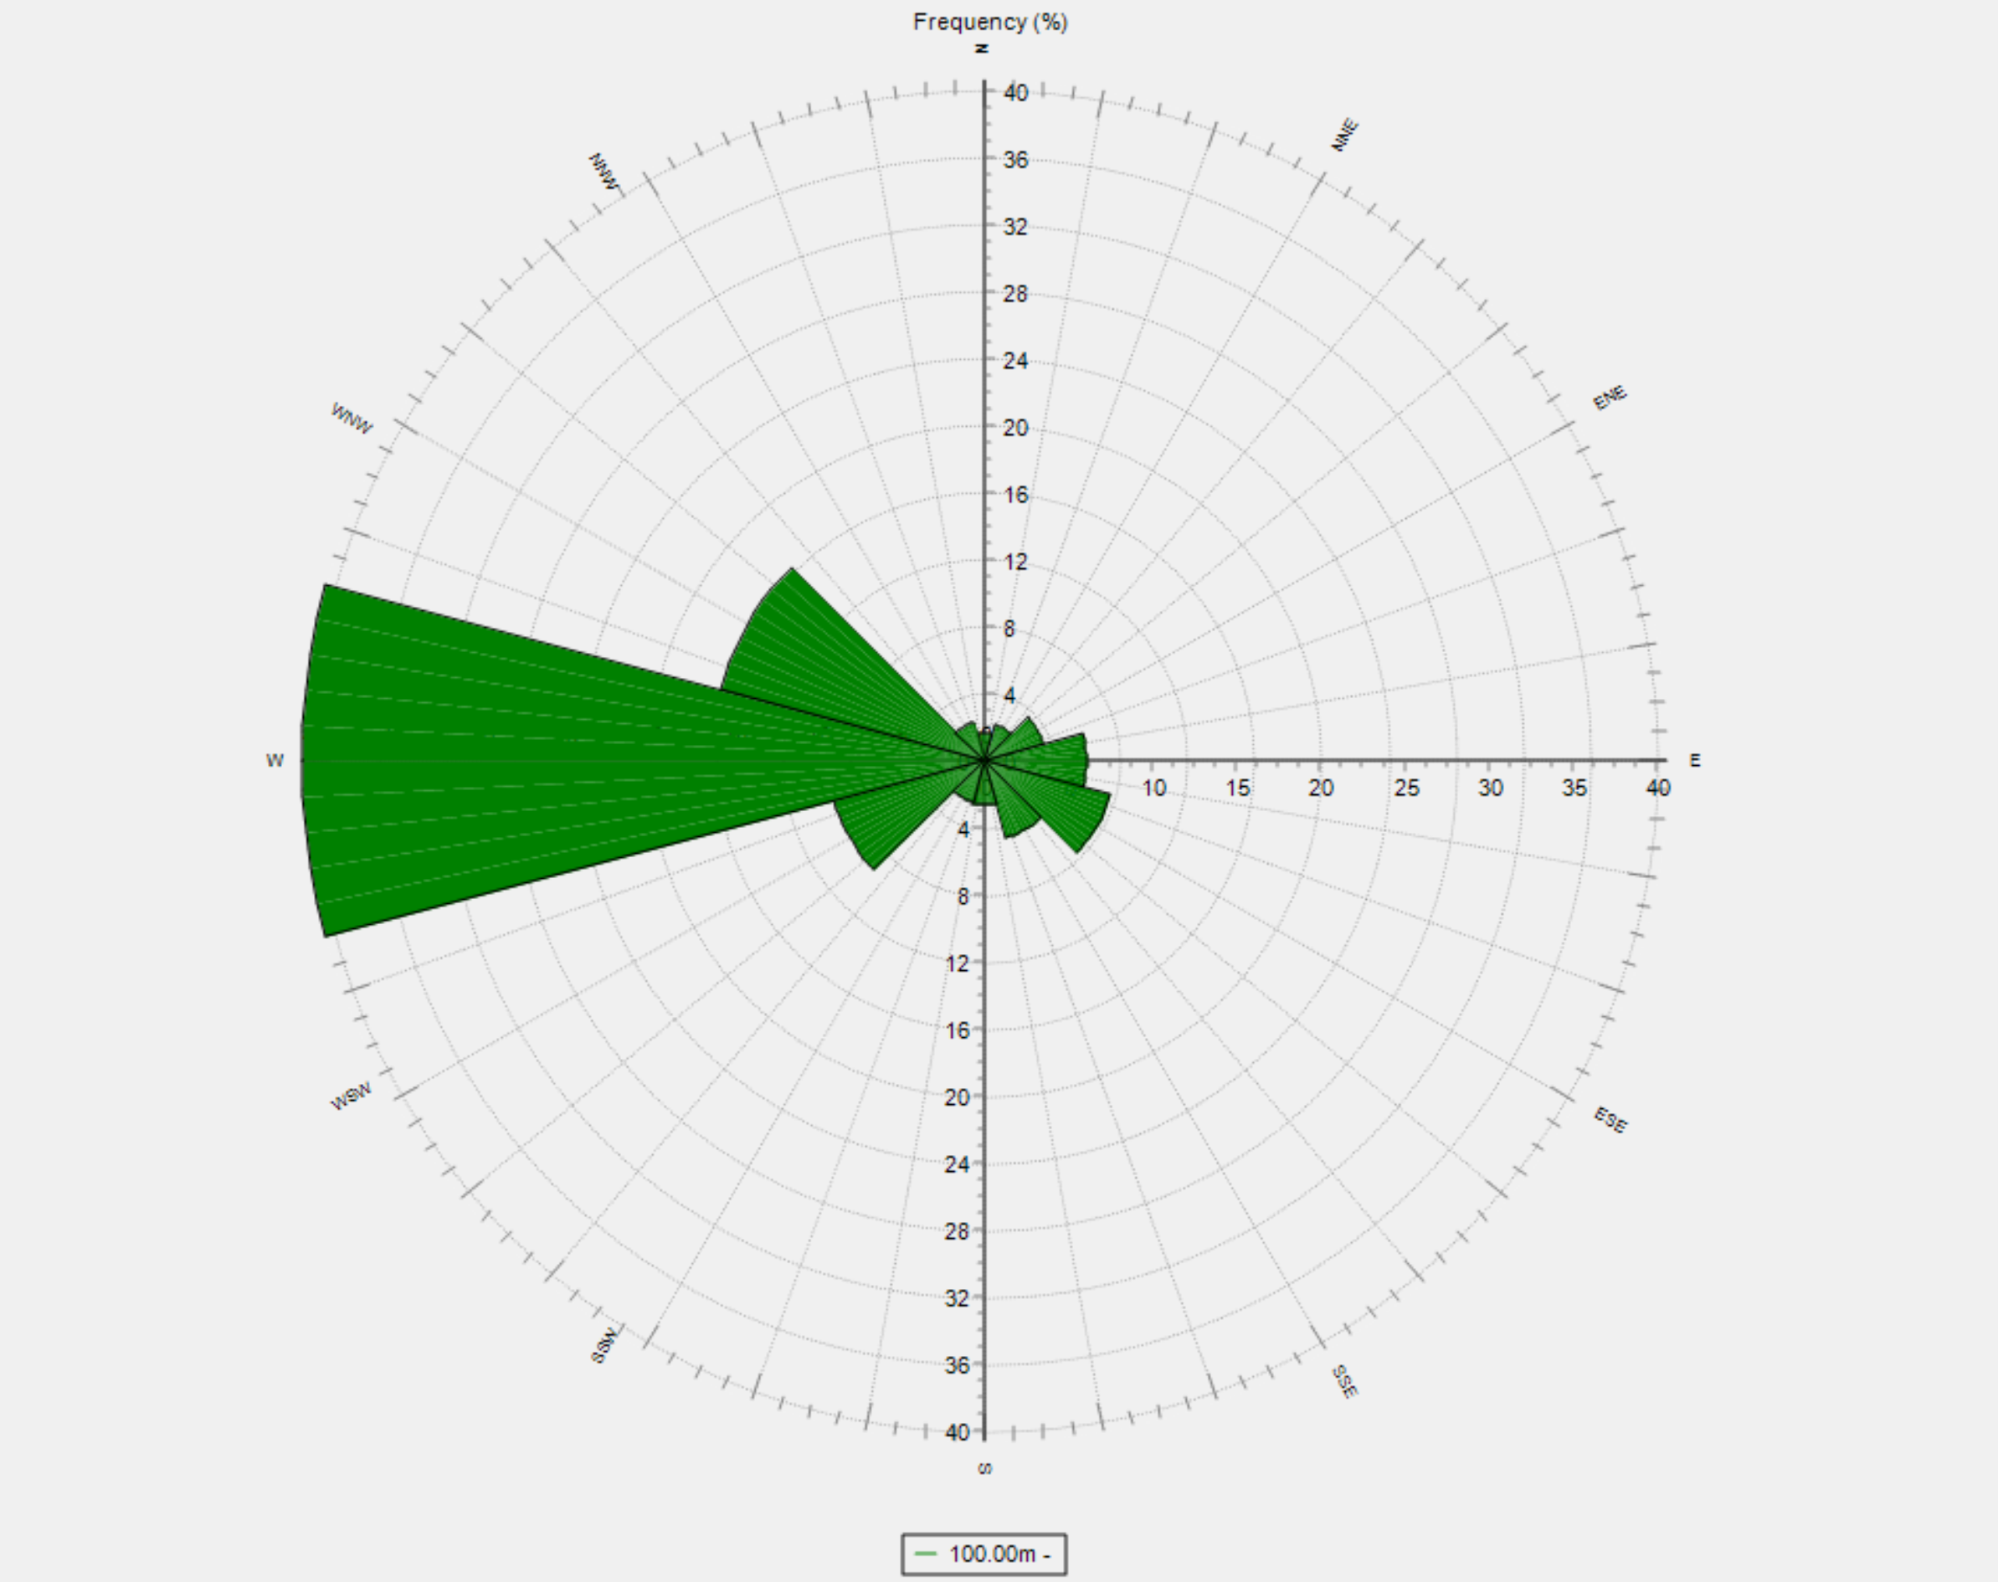
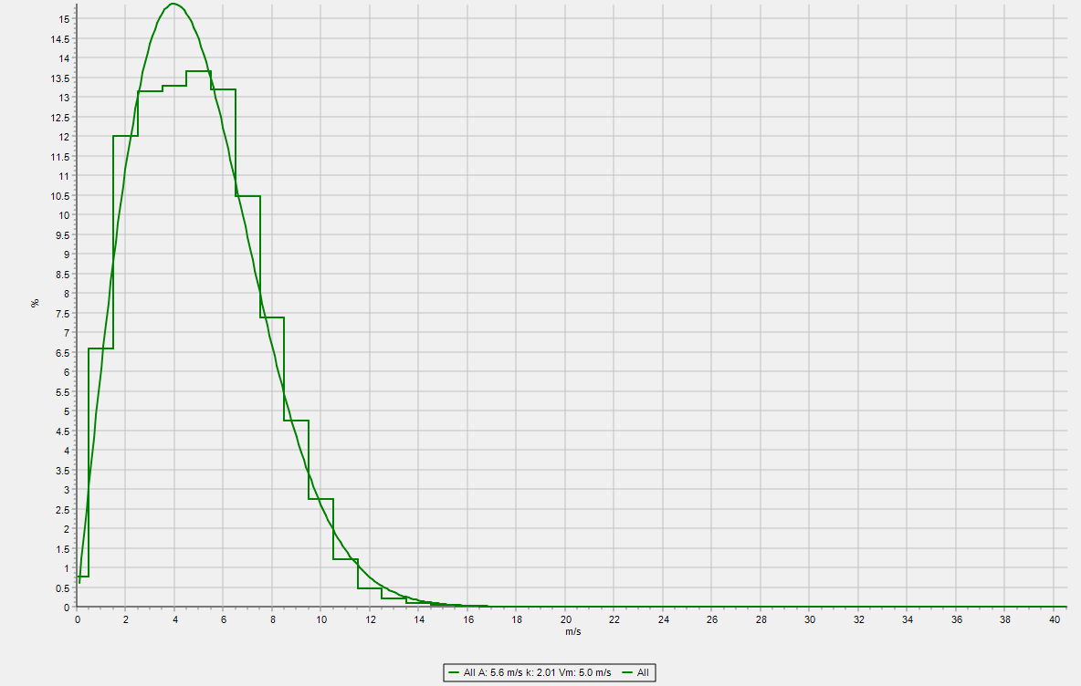
Progress: WindPro Simulation
Wind Ressource Implementation in the WindPro model:
Long Term Data – ERA5 (Gaussian Grid)
1995 up to 2025, 30 years
Different from measured data (lower)
8 km from location
Lonf Term Data – ERA5(T) (Rectangular Grid)
30 years, very similar to first LTD, 13 km
Trying to include the measured data
Failed so far, need to review again
Including StatGen
For the generation of Wind Statistics
Including ResGen
For the generation of Wind Energy Resources
Need to try again with measured data
Setup of WTG
Starting with 5 MW turbine (SG 5.0-145 @ HH102m, for assumption)
Will be echanged when final turbine data available
Figure 1: Screenshot of the wind rose at 100m in WindPro [8]
Figure 2: Screenshot of the Weibull distribution at 100m in WindPro [8]
Sila Ceren Cetin

Slide 8
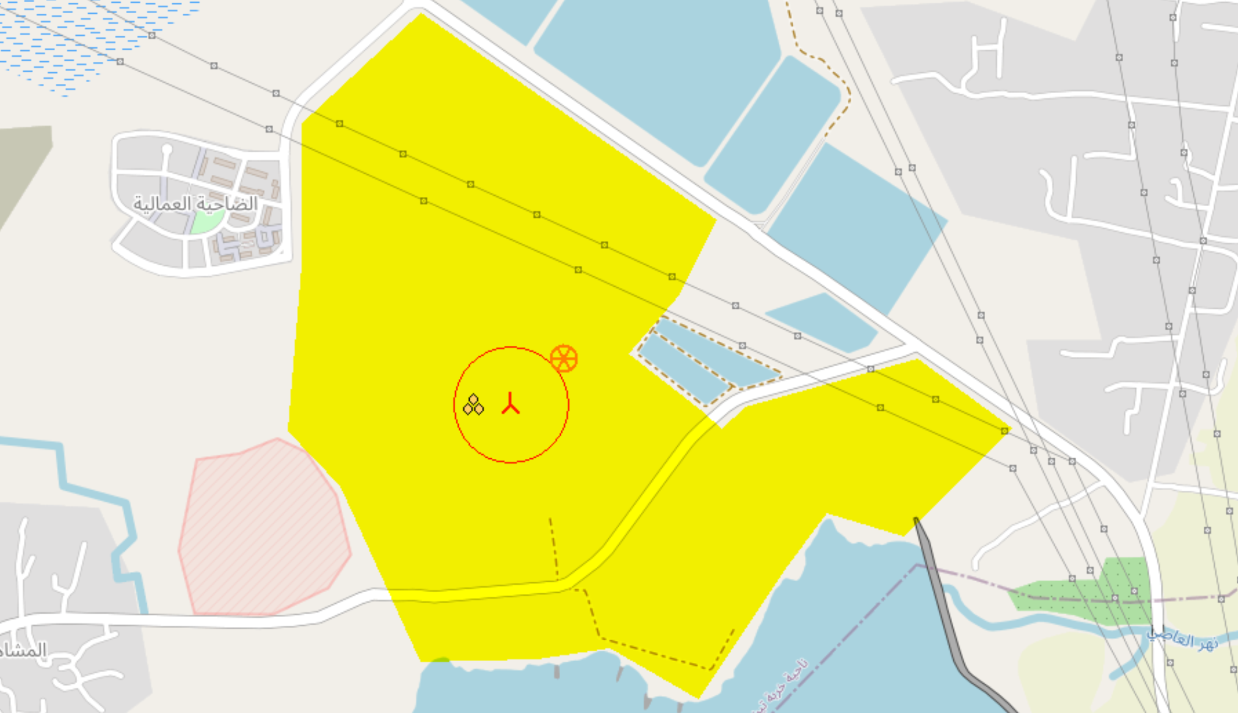
Progress: WindPro Simulation
Critical to build a larger Wind Farm
Close to the buildings
Close to the powerline
Figure 3: Screenshot of the Optimus Turbine location [8]
Sila Ceren Cetin

Slide 9
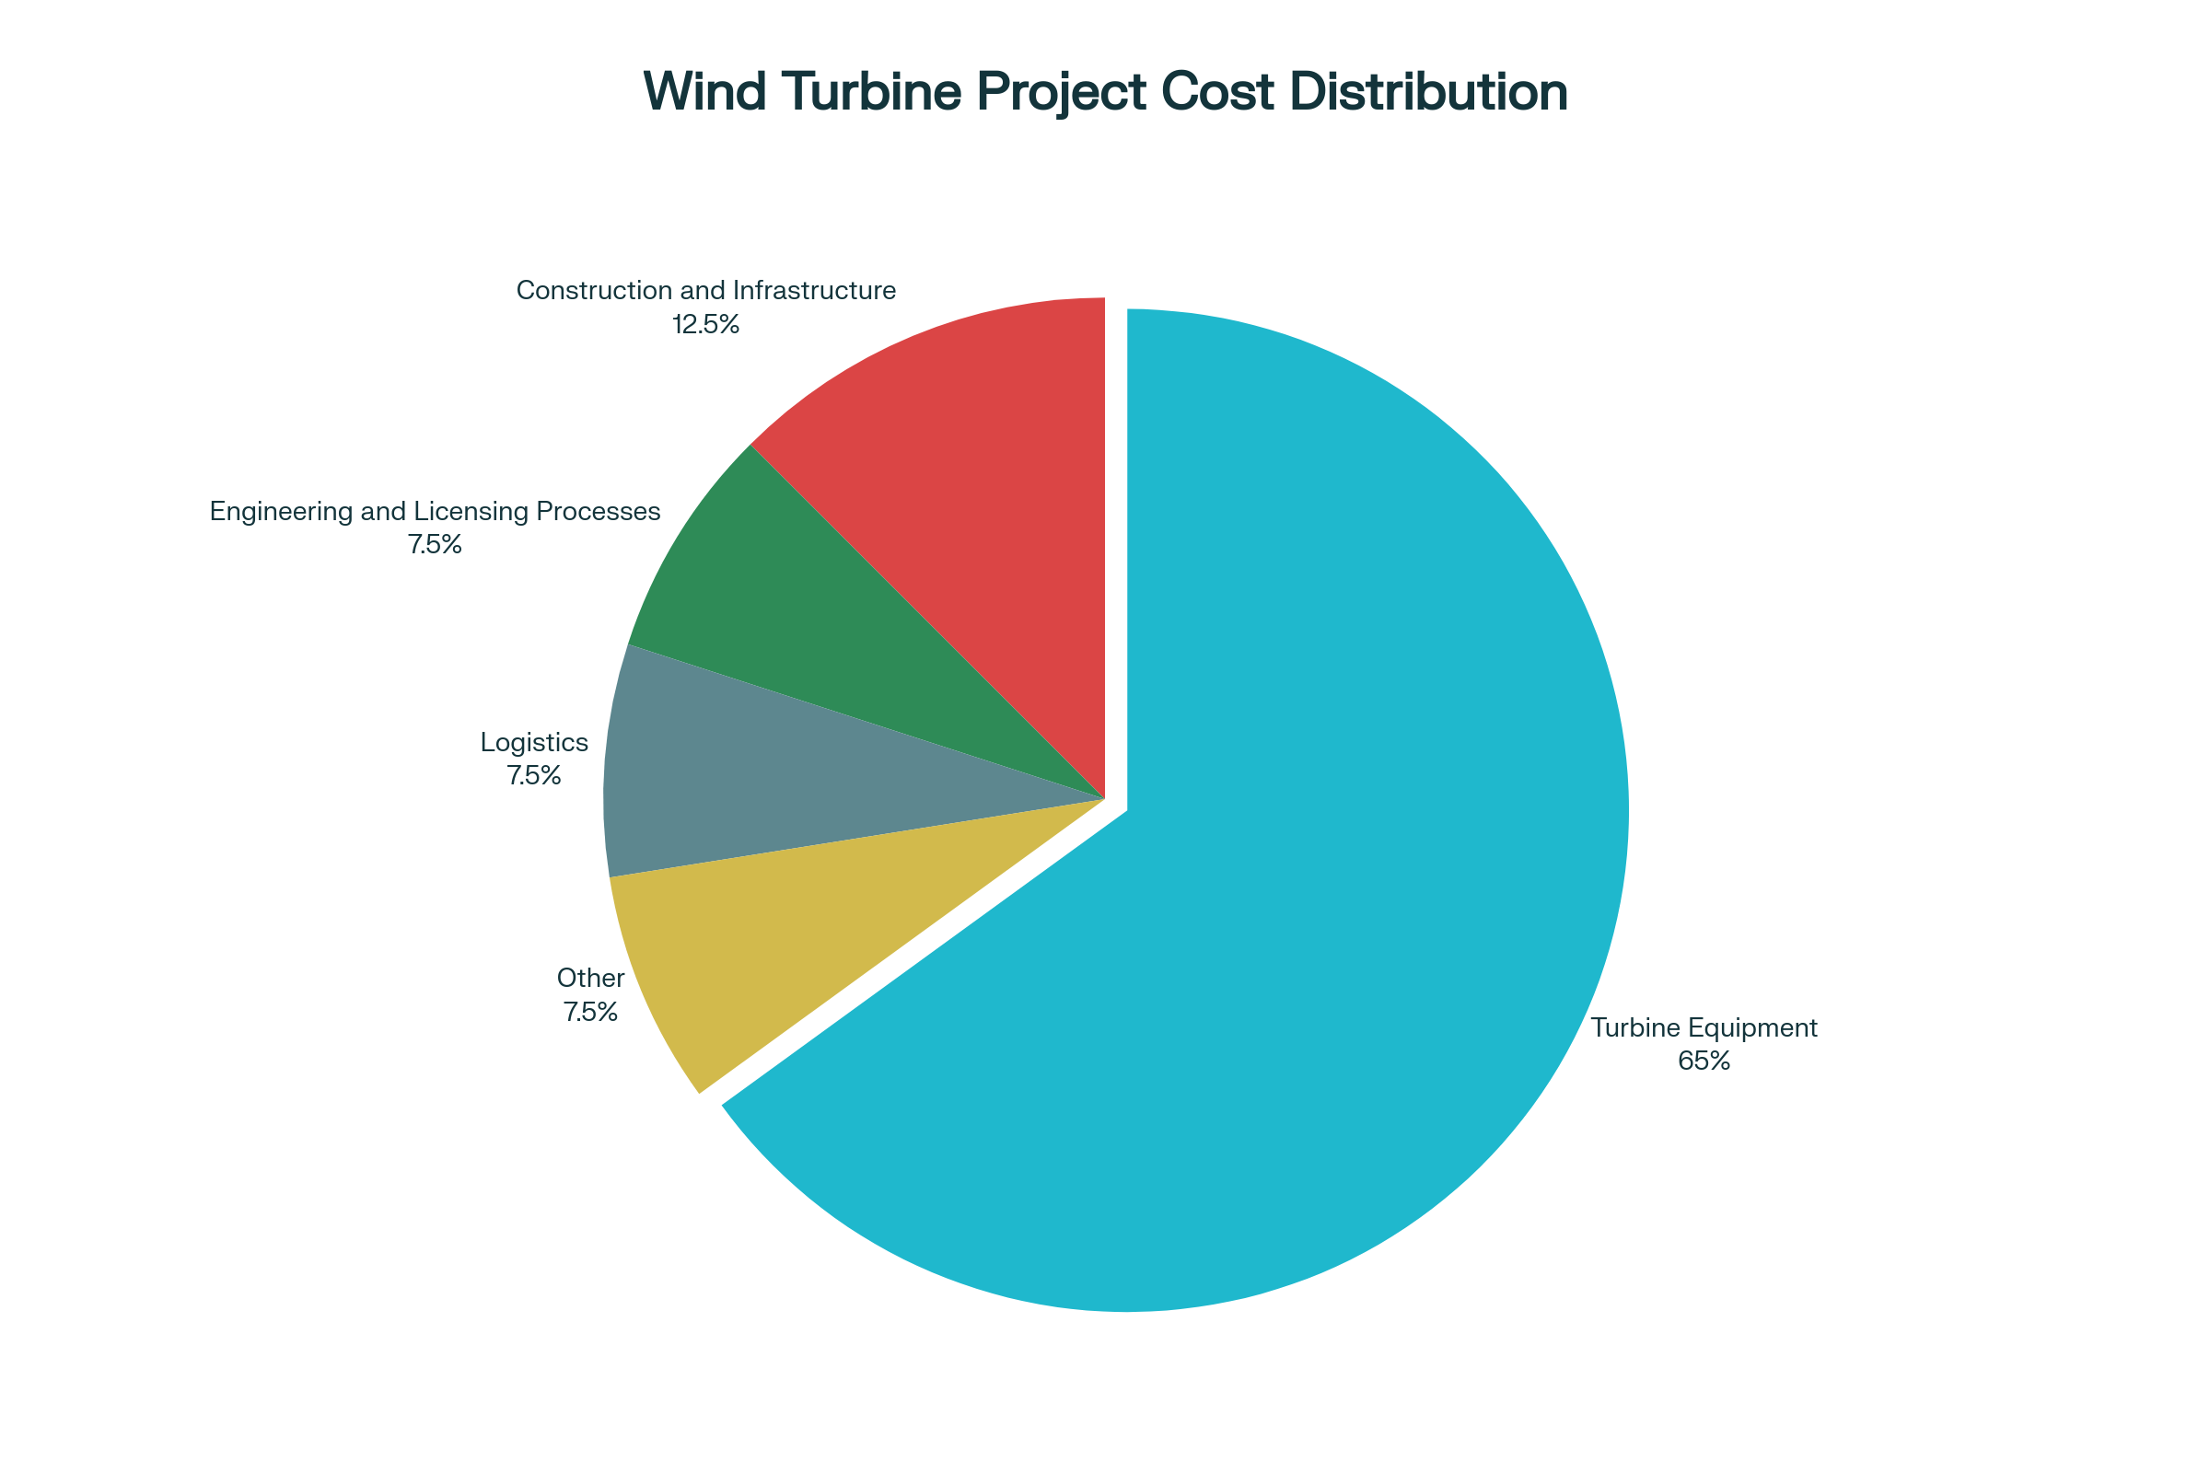
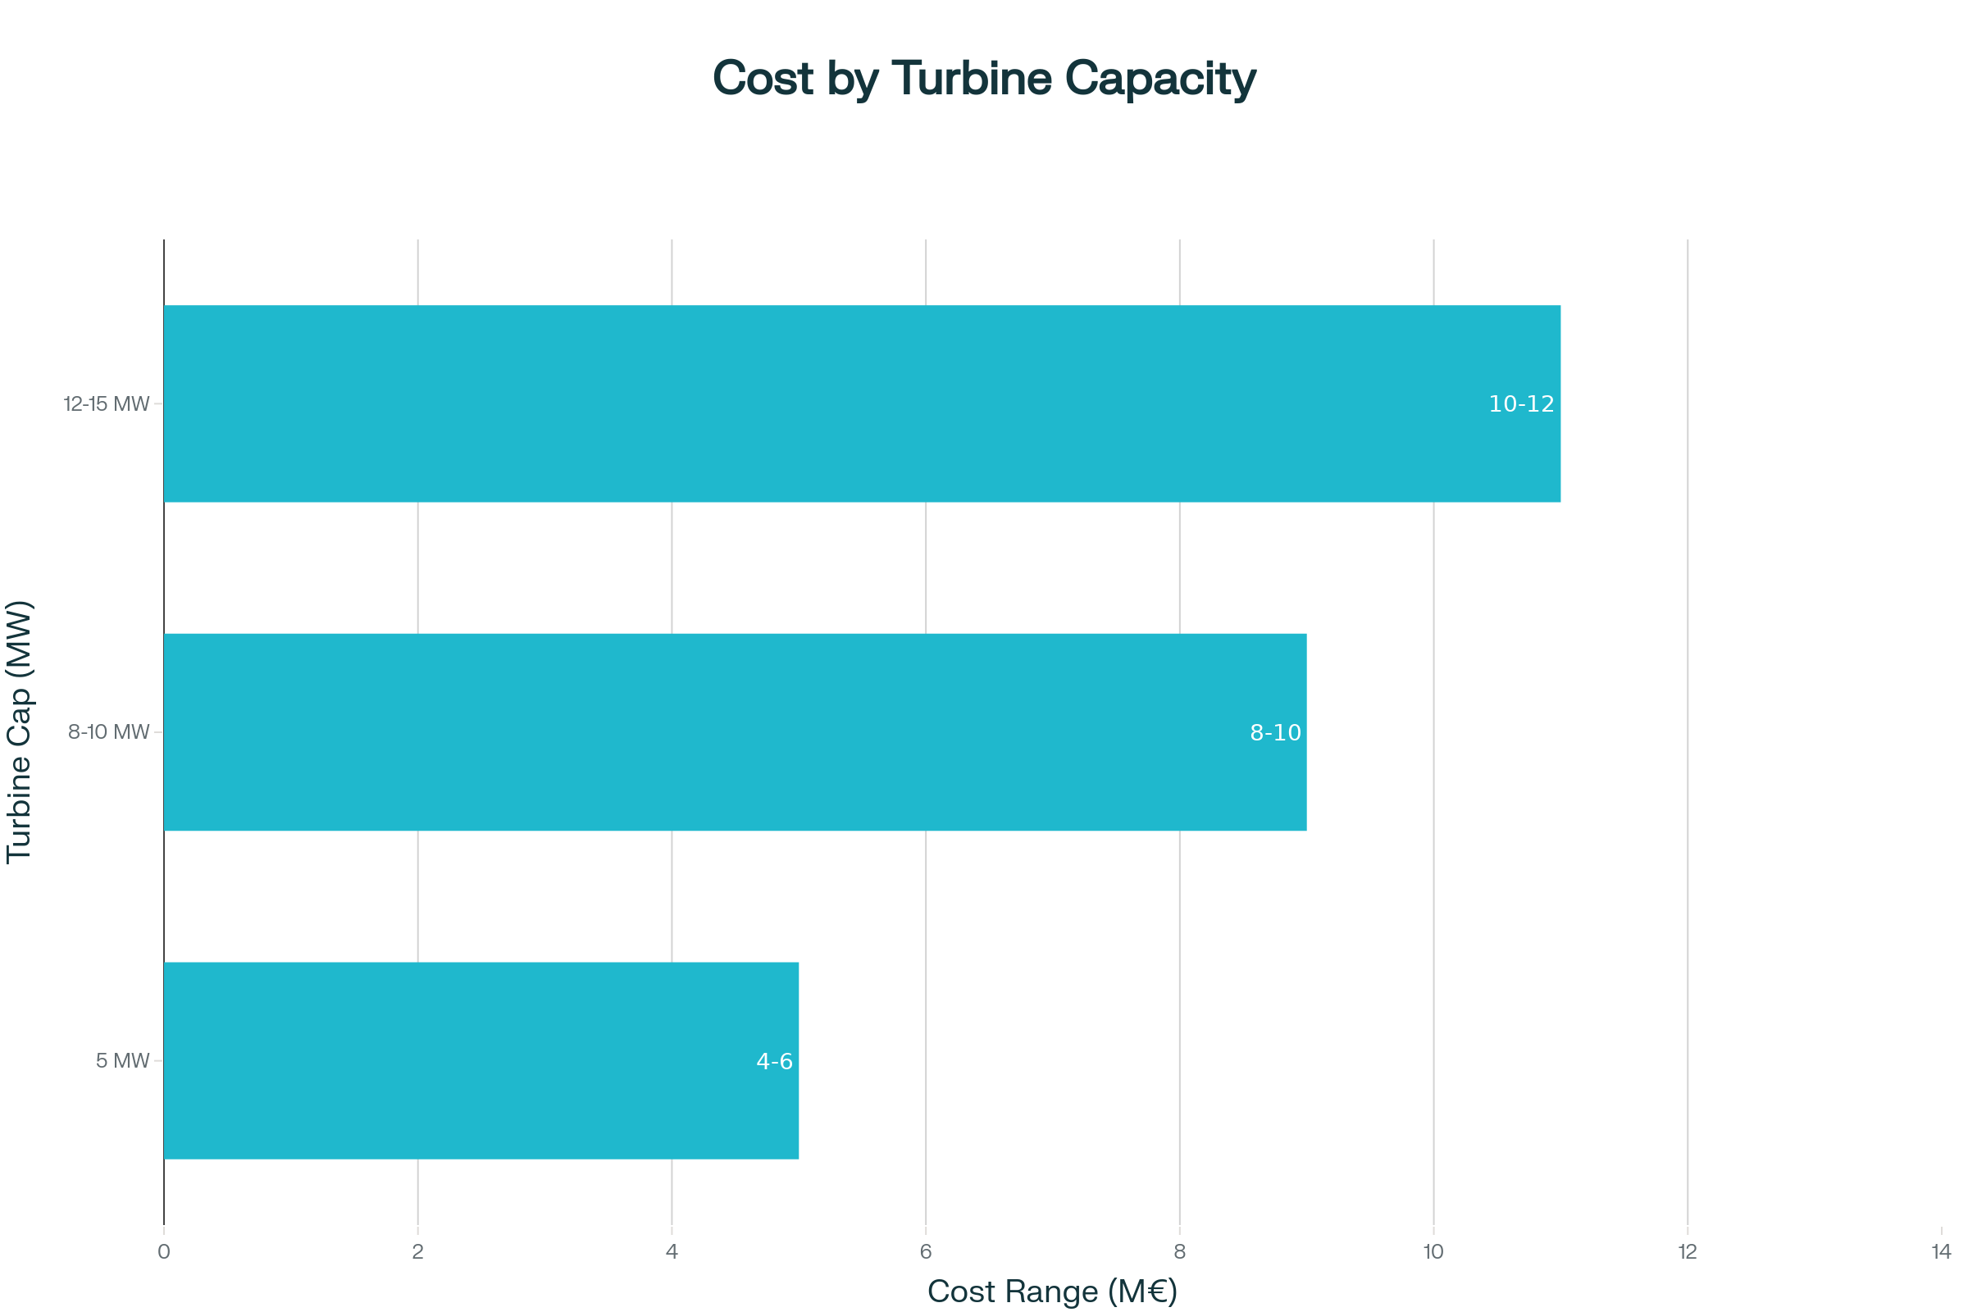
Wind Turbine Cost Distribution in Turkey
[8]

Slide 10
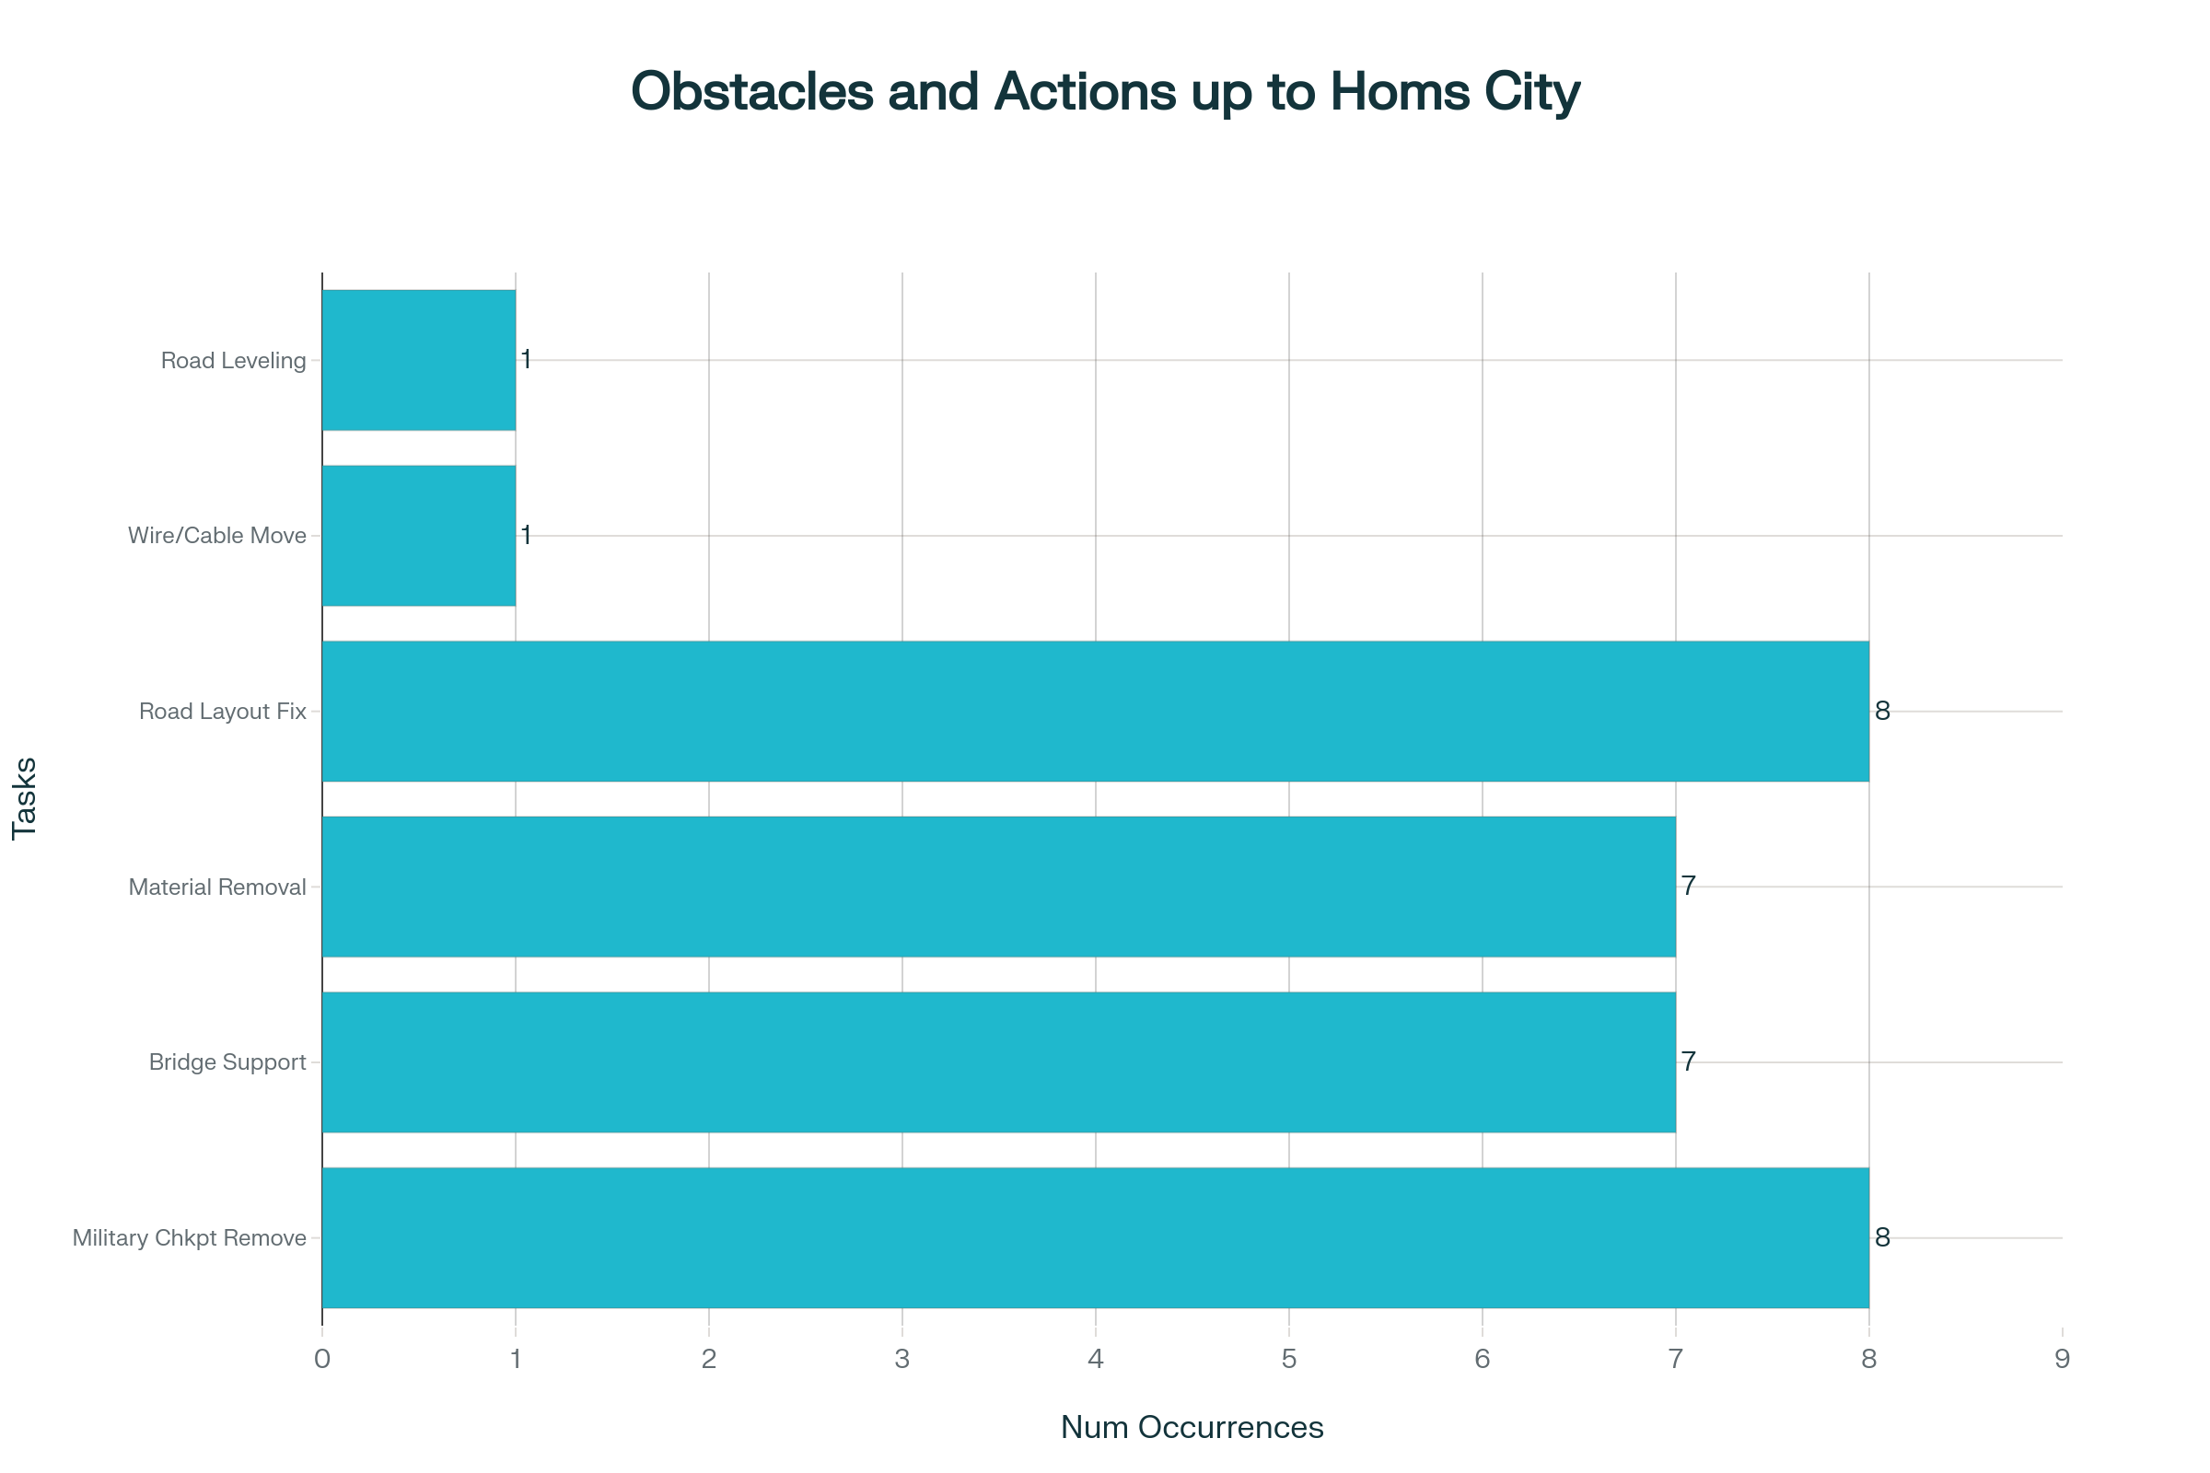
Transportation: Tartus Port-Homs City
Military checking point should be removed: 8
Bridge has to be supported: 7
Concrete/block/material/stockpile removal: 7
Road/bypass/turn/exits/layout intervention: 8
Electric wires and Telephone cable should be moved up: 1
Road leveling is needed: 1
[7]

Slide 11
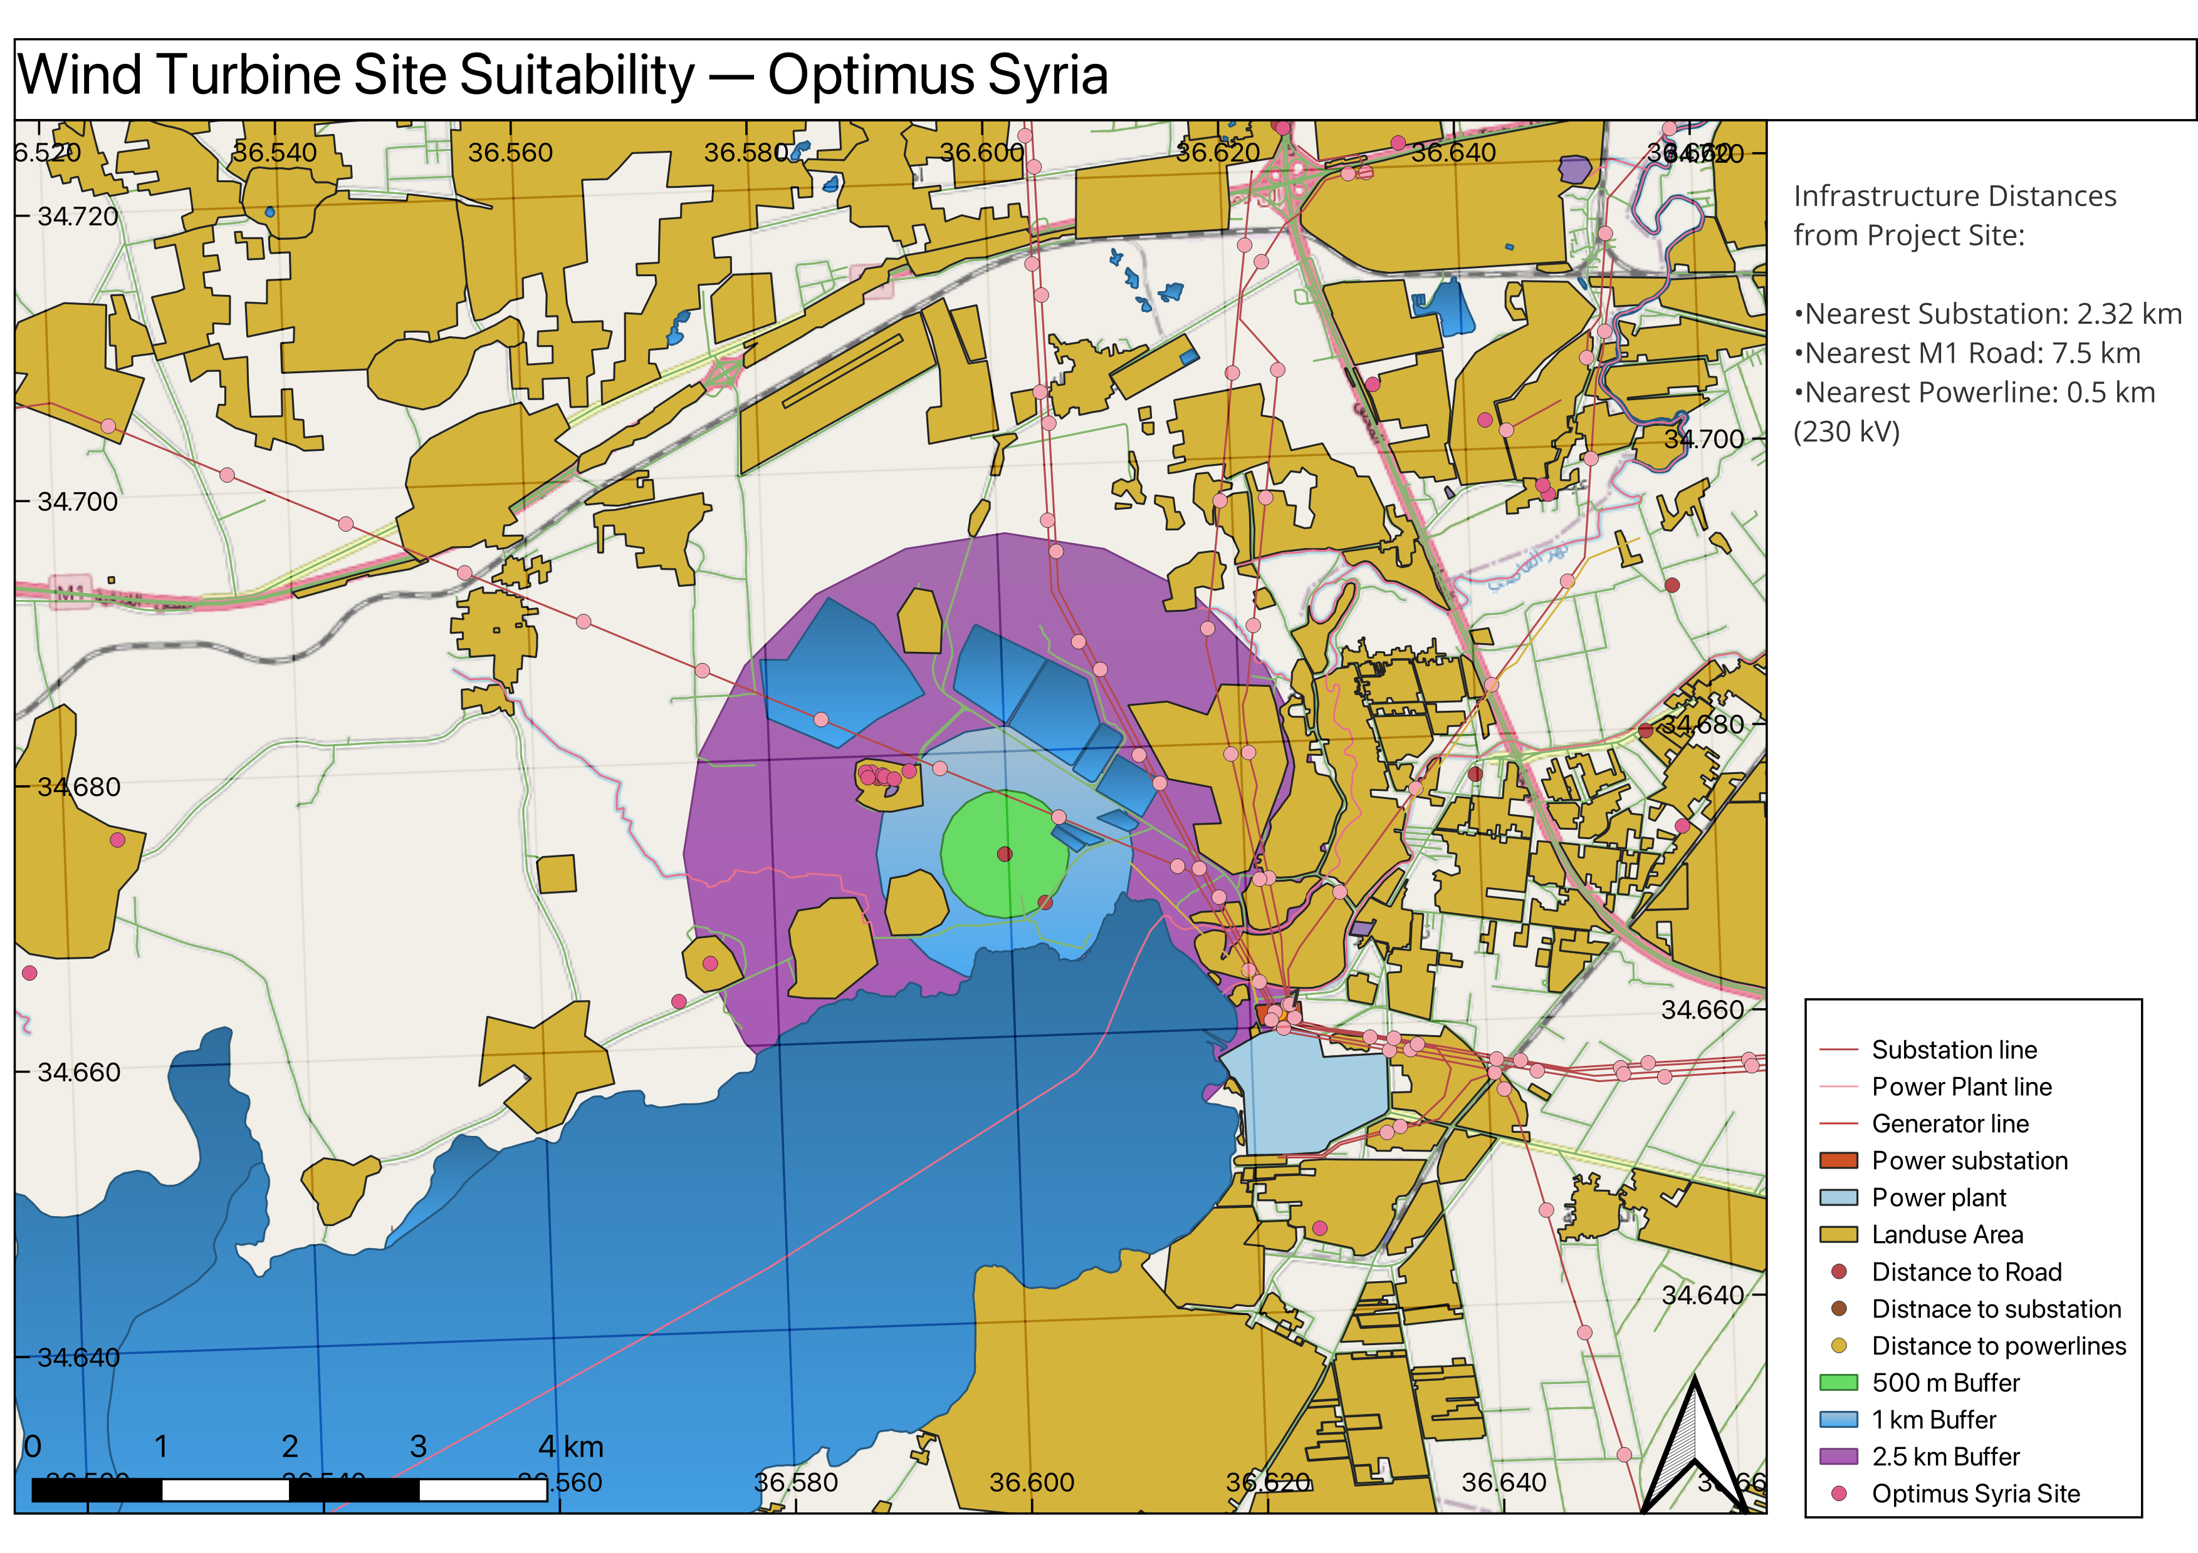
Progress : Detaile Site Analysis (QGIS)
[9]]
Sila Ceren Cetin

Slide 12
Bibliography – Project Development
[1] WindPro, University License for WindPro [Software] (latest on 30.10.25)
[2] Syrian Energy Prices, GlobalPetrolPrices. [Online]. Available: Syria energy prices | GlobalPetrolPrices.com (latest on 28.10.25)
[3] Study Levelized Cost of Electricity Renewable Energy Technologies, ISE-Fraunhofer [Document]. https://www.ise.fraunhofer.de/content/dam/ise/en/documents/publications/studies/EN2024_ISE_Study_Levelized_Cost_of_Electricity_Renewable_Energy_Technologies.pdf (latest on 28.10.25)
[4] https://www.wind-energy-the-facts.org/operation-and-maintenance-costs-of-wind-generated-power.html
[5] https://english.enabbaladi.net/archives/2025/09/loans-starting-at-e50-million-offered-for-renewable-energy-projects-in-syria/ [6] Damacus university shared files IRENA_Power_Generation_Costs_2021_pdf
[7] Inspection road between Tatous and dier Ali power plant, unpublished report, 2025.
[8] Wind Turbine Prices, Cost Analysis, and 1 MW Turbine Profit - Comprehensive Guide," Aldatmaz Global, [Online]. Available: https://aldatmazglobal.com/ruzgar-turbini-fiyatlari-maliyet-analizi-ve-1-mw-turbin-kazanci-kapsamli-rehber/. [Accessed: 30- Oct- 2025]
[9] QGIS, Public Software [Software]
Sila Ceren Cetin

